Slide 1

Module Code: SOFT40161 Module Name: Introduction to Computer Programming Lecture 04: Functions, Modules, Argument Passing, Recursion and Exceptions (Week 14:04)
M. Arifur Rahman, PhD
Department of Computer Science, NTU
Arif.Rahman@ntu.ac.uk

Slide 2
Module Contents and Our Plan!
Lecture | Week | Topic | Comment
Lecture 01 | Week 11 | Module Introduction, Programming Basics: Python Environment, Installation, Variables, Data Types and Operations | Done!
Lecture 02 | Week 12 | Procedural Programming: Control Structures with Python (Sequence, Branching, Conditions and Looping) | Done!
Lecture 03 | Week 13 | Data Structures Concepts in Python (Lists, Tuples, Sets and Dictionaries) and Code Quality Considerations | Done!
Lecture 04 | Week 14 | Functions, Modules, Argument Passing, Recursion and Exceptions | This Week!
Lecture 05 | Week 15 | Concepts of Object-Oriented Programming (Classes, Methods, and Constructors)
Lecture 06 | Week 16 | Working with Data: File I/O and Data Handling and NumPy Operations
Lecture 07 | Week 17 | Data Manipulation with Pandas and Python Libraries
Lecture 08 | Week 18 | Data Visualization: Basic to Customisation
Lecture 09 | Week 19 | Working with Real-World Data, Python for Machine Learning
Lecture 10 | Week 20 | GUI with Python, Coursework, Projects and Review

Slide 3
Learning Outcomes (LO) of this Lecture:
LO-01: Remember Python functions, modules, and exceptions.
LO-02: Understand argument passing, including positional and keyword arguments.
LO-03: Apply modular programming with functions and modules.
LO-05: Evaluate error handling with exceptions.
LO-04: Analyse problems using recursive solutions.

Slide 4
Roadmap for today
Complex Program
Basic functions
Nested Functions
Variable scope
Recursion
Argument Passing

Slide 5


Modularisation: Context MSc in CS @ NTU
Academic Year
Other Department, Modules @NTU
Term 1
Intro. Comp Prog
Found. AI
Adv. Soft. Engin.
Comp. Forensics
Info Security Mange.
Students
Term 2
Comp Security
Soft. Project Mgt.
Stat. Data Analysis
Big Data & Inf
Ethical Hacking
Term 3
Net & Cloud Security
Soft Design & Devp.
Applied AI
Research Methodology
Summer
Masters Major Project
Progression Board

Slide 6
Modularisation: Context MSc in CS @ NTU
Academic Year
Other Department, Modules @NTU
Term 1
Intro. Comp Prog
Found. AI
Adv. Soft. Engin.
Comp. Forensics
Info Security Mange.
Students
Term 2
Comp Security
Soft. Project Mgt.
Stat. Data Analysis
Big Data & Inf
Ethical Hacking
Term 3
Net & Cloud Security
Soft Design & Devp.
Applied AI
Research Methodology
Summer
Masters Major Project
Progression Board

Slide 7
Complex Program
Up to now, your programs have been quite small
As you build more complex things, they get harder to manage
And it becomes very hard to work out what will happen next…
Any program bigger than a screenful can be hard to understand
How do some people write a program?
Jump in and write something (no thinking)
No design, or clear idea, on how to solve a problem
No real thought about the problem to be solved in the first place
No thought on testing to ensure program does what it is supposed to
Lacks structure and documentation leading to inefficient and overly complex code
Need to think about better ways of designing and developing software…

Slide 8
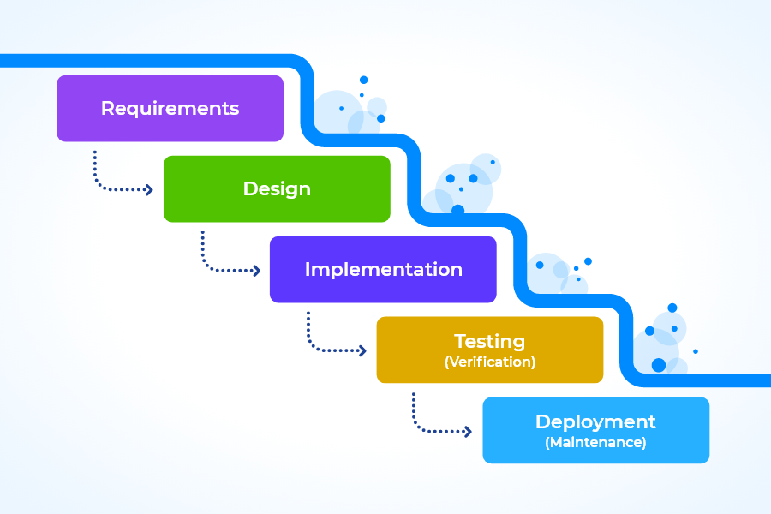
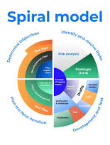
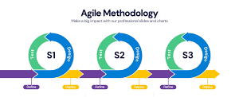
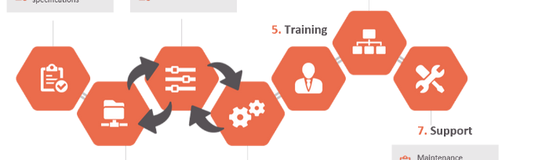
Complex Program - Developing Software
To develop software, we need to have a plan (i.e. some form of structure) to get form idea to end-system.
The Waterfall Model provides you with clear project phases.
Advantages:
Highly structured with clear phases and deliverables
Easy to evaluate project progress
Disadvantages:
Requires perfect decision-making
Projects rarely follow a simple sequence
Iterations and revisions are almost inevitable
There are better methods (investigate in your own time)

Slide 9
Program complexity – revisiting the bmi problem
Structured English for calculating BMI:
Flow chart for calculating BMI:
Set Height and Weight to be zero
While Height invalid
Prompt user and get Height
While Weight invalid
Prompt user and get Weight
Calculate BMI
If BMI>25, tell user they are too heavy
Else if BMI<18, tell user they are
underweight
Else tell user they are perfect!

Slide 10
Complex Program: Problem?
Complex programs don’t stop the program from getting long or hard to understand. We need a way to separate out ‘chunks’ of the program to keep the areas of complexity isolated.
We write our own FUNCTIONS which separate out well defined behaviours
Then we can make our main program relatively simple and clean
We can test the functions individually before we put them together

Slide 11
Calling ‘Program Block’ and Argument Passing
Python
Scripting
Environment
def factorial(n):
if n == 1:
return 1
else:
return n * factorial(n - 1)
Return Value
Result = factorial(n )
Message Passing (n)

Slide 12
What is Function?
A reusable block of code that is designed to perform a single, related action. Functions help to organize code into manageable, logical sections and promote code reusability.
Modular Design: Breaks down complex programs into smaller parts
Code Reusability: Write once, use multiple times
Abstraction: Hides complex tasks, simplifies code usage
Encapsulation: Protects internal code, exposes only what's necessary
Maintainability: Easier debugging and code updates

Slide 13
Why use Function?
Avoid Redundancy: Eliminate code repetition
Simplify Code: Improves readability and structure
Enhance Testing: Isolate components for easier debugging
Scalability: Allows code to grow more efficiently
Collaboration: Promotes teamwork and modular development

Slide 14
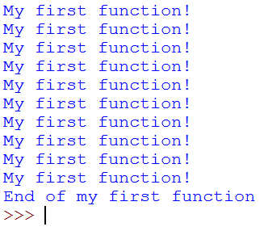
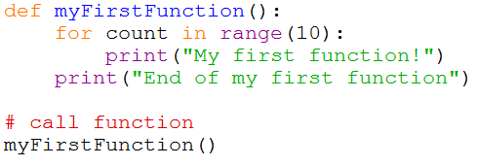
Basic Function?
A function allows us to break our program down into smaller re-usable chunks. We have been using functions in our programs so far (print(), randint(), range(), input(), etc…) – these are all functions.
A function is structured as follows:
def <function name> ( [<parameters>] ):
<code block>
Example:

Slide 15
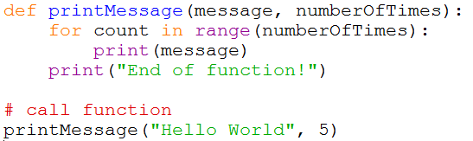
Syntax and Parameters
Functions have a signature:
def <function name> ( <parameter>,[<parameter>]* ]):
The signature is made up of:
Function name
Parameters
Parameters are variables which will contain information that have been passed in and can be used within the function.
Example
Variables

Slide 16
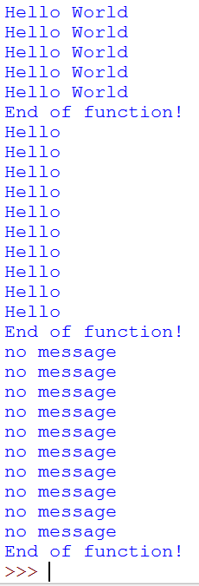
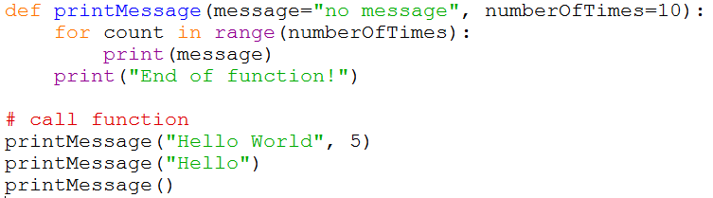
Parameters - Defaults
Function parameters can also have default values associated with them so that if they are not passed in, the default is used instead.

Slide 17
Calling Functions and Argument Passing
Case 01
Case 02
Case 03
Case 04
Called Function
Called Function
Called Function
Called Function
No Return Value
Some Return Values
No Return Value
Some Return Values
No Mess-age Value
No Mess-age Value
Some Mess-age Value
Some Mess-age Value
Calling Function
Calling Function
Calling Function
Calling Function

Slide 18
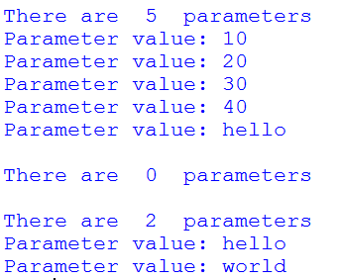
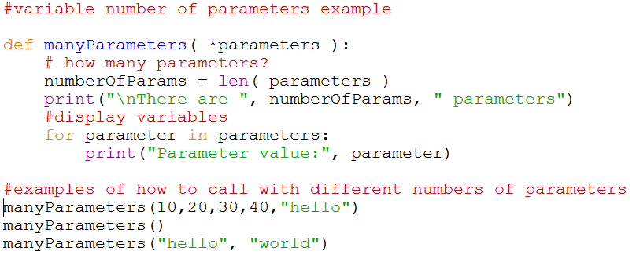
Variable number of parameters
So far, functions can have an explicitly defined number of parameters.
What if we don’t know how many parameters to expect? (e.g. print)
In the parameter list, use * followed by a parameter name.

Slide 19

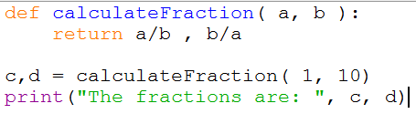
Returning Values
Functions can return information which has been created or manipulated within the function using the return keyword.
You can also return more than one value by using commas.

Slide 20
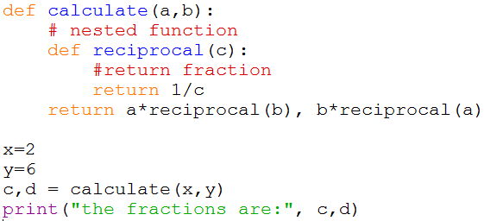
Nested functions
Functions could also have functions defined within them.
These would only be visible to the outer function.

Slide 21
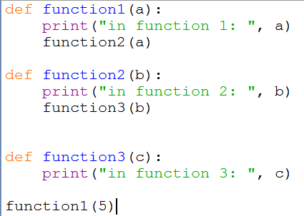
The Stack – Calling Functions
The stack stores temporary data in relation to a function:
Function call details including parameters
Local variables
Return addresses
Function3
Parameters(s): c
Local variables
Return address
Function2
Parameters(s): b
Local variables
Return address
Program Stack
Function1
Parameters(s): a
Local variables
Return address

Slide 22
The stack – calling functions
The stack stores temporary data in relation to a function:
Function call details including parameters
Local variables
Return addresses
Function3
Parameters(s): c
Local variables
Return address
Function2
Parameters(s): b
Local variables
Return address
Program Stack
Function1
Parameters(s): a
Local variables
Return address

Slide 23

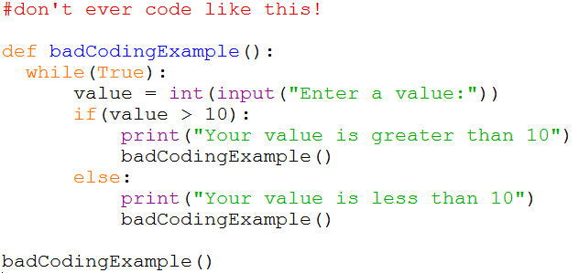
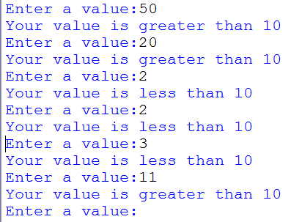
Don’t use functions like this!
When using loops, don’t call the function again…
Seems ok, but is it?
What is wrong with this?

Slide 24
Problems – Variable Scope
Variable scope dictates where it can be seen and not be seen.
i.e. can the variable be accessible within the current code block?
a is pushed on to the stack (5)
a is pushed on to the stack (10)
>>> def scopeExample():
a = 5
def innerScopeExample():
a = 10
print(“The value of a in the inner scope is =”, a)
innerScopeExample()
print(“The value of a in the outer scope is =”, a)
>>> scopeExample()
The value of a in the inner scope is = 10
The value of a in the outer scope is = 5
outer scope block
inner scope block
Inner scope code block (function) now runs
Now leave inner scope (its stack is now removed)
Leaves a = 5
Why?

Slide 25
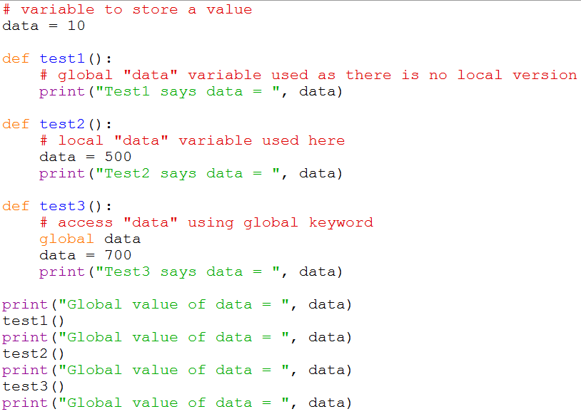
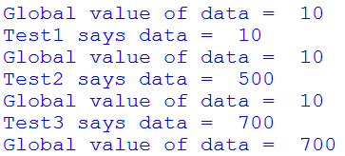
Global variables
Because variable scope affects the visibility of a variable, you could use the global keyword!
Question: Is it a good idea to use global/global variables?

Slide 26
Advanced topic: Recursion
We can use recursion to solve a problem by using itself.
Here, you would define a function to solve a bit of the problem and then keep calling itself until it solves the whole problem.
A recursive function has three distinct parts:
The base case which tells you when to stop
Working towards the base case where the problem is broken into smaller parts
Calling the recursive function
Useful when we need to solve problems which need to search for things.
E.g. directories on your hard disk, searching for a shortest path, etc.

Slide 27
Recursion example – Depth First Search
DFS( v )
visit v
for each child c of v
DFS( c )
File Contents:
My Documents
downloads
Lab1.pdf
favourites
C:\
ntu.url
google.url
data.txt
python
My Documents
data.txt
python
python32.exe
include
abstract.h
accu.h
downloads
favourites
python32.exe
include
readme.txt
readme.txt
Lab1.pdf
ntu.url
google.url
abstract.h
accu.h

Slide 28
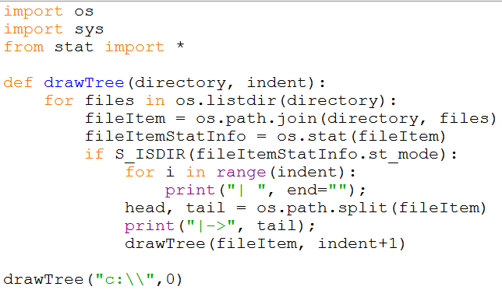
Recursion example – Adapting DFS
Directory Tree example:
Problem: if you hit something you haven’t got access to it crashes. ☹

Slide 29
Exception handling
When things go wrong, an exception is usually generated.
For example:
Accessing an index of a list that does not exist:
myBuffer[89]
Traceback (most recent call last):
File "<pyshell#38>", line 1, in <module>
myBuffer[89]
IndexError: list index out of range
Number of built in exception types (investigate what these are)
Used in code to capture when something has gone wrong (and not to crash and terminate the program)

Slide 30
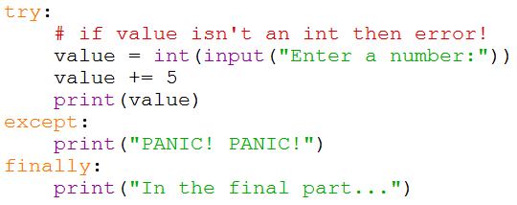
Exception handling
1. Execute the code in the try block.
2. If no error occurs, skip the except block and do the instructions in the finally block.
3. If an error occurs during the try block, skip the rest of the code and start performing the code in the except block.
a) Need to run the correct except block for the error that has occurred. If no except block defined for error, an unhandled exception error is generated.
Note: in the above example, just using except: will capture all exceptions.

Slide 31
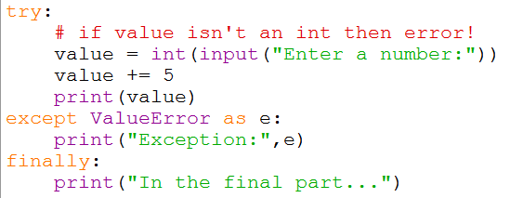
Exception handling types
Instead of capturing ALL exceptions, we can be specific:
There are lots of exceptions:
https://docs.python.org/3.7/library/exceptions.html

Slide 32
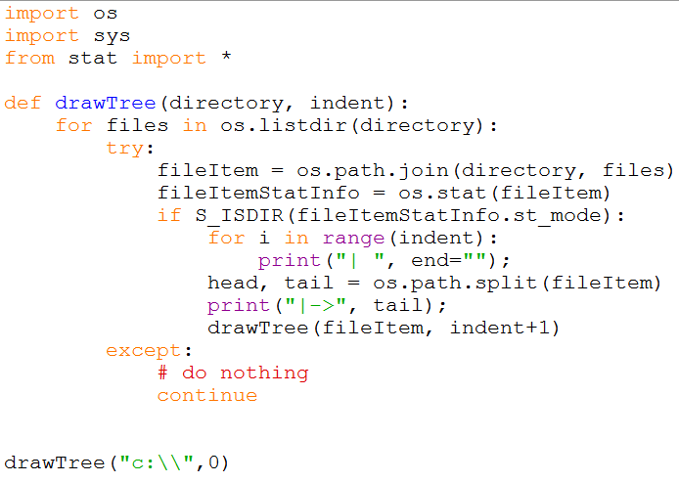
Putting it all together (revisiting recursion)

Slide 33
First exposure to Object Oriented programming (OOP)
Defining functions will only you take you so far.
More complex systems require you to start thing about components and objects.
In real-life we think about things in terms of objects.
For example, when you think about a table, we tend to break it down into its component blocks.
A table is made out of four tables legs and a table top.
Object-oriented programming can be thought about in the same terms whereby smaller units (objects) are used to describe its behaviour (functions) and state (data).
Exercise: with a partner, think about what “things” make up the lecture theatre you are sitting in.
Next Lesson

Slide 34
Summary
How to create and call functions
Parameters and returning values
Variable scope
Recursion
Next time, object-oriented programming…

Slide 35
Directed Study
Revisit past code examples and re-develop them using functions, parameters and return values
Advanced tasks:
check out https://www.oodesign.com/
Read chapters 8 & 9.
References:
[1] Sommerville, I., Software Engineering, 7th Edition, Addison Wesley, 2004

Slide 36


